Slide 1

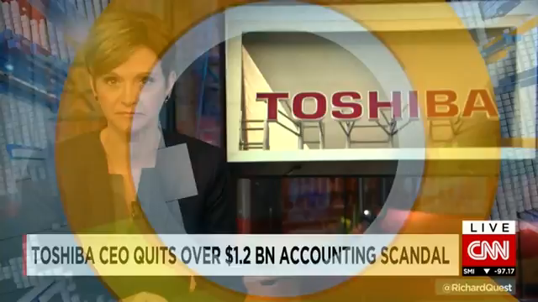
Toshiba CEO quits over -1.2 billion accounting scandal

Slide 2
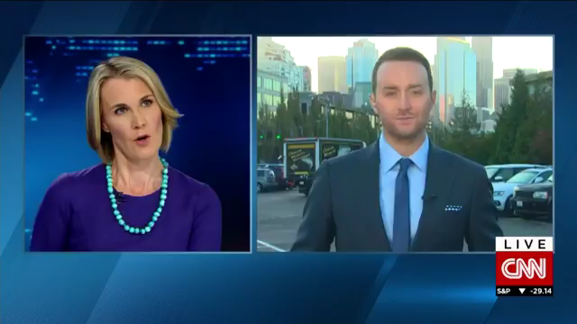
Toshiba CEO quits How will Volkswagen fix emissions scandal -1.2 billion accounting scandal

