Slide 1
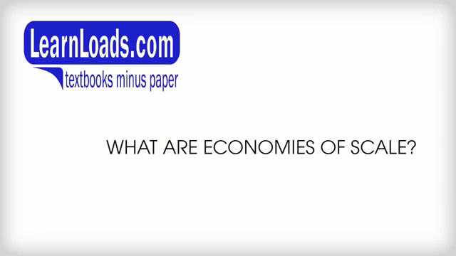
VIDEO - Economies Of Scale

Slide 2

VIDEO - Economies Of Scale

Slide 3

VIDEO - Sources of Economies of Scale

Slide 4

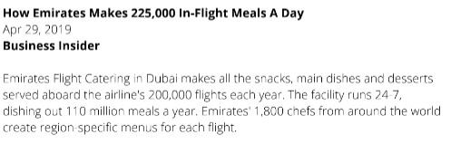
AMAZON WAREHOUSES
VİDEOS
SCALE OF OPERATIONS – MONSTER INC – VIDEOS
SCALE OF OPERATIONS – EMIRATES AIRLINES CATERING – VIDEOS
Notes:
https://www.youtube.com/watch?v=4hkr_19kXdI&t=11s
https://www.youtube.com/watch?v=m7RlIhi3OXc
------
https://www.youtube.com/watch?v=4wkvaEM4bIg

Slide 5
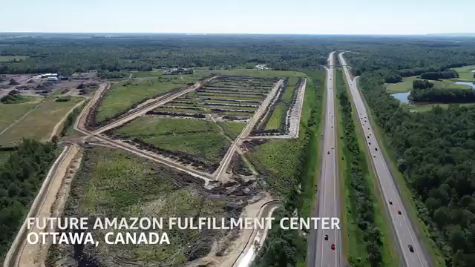
VIDEO - See a new Amazon warehouse rise from the ground up

Slide 6

VIDEO -Amazon Showcases Robots at New Warehouse

Slide 7
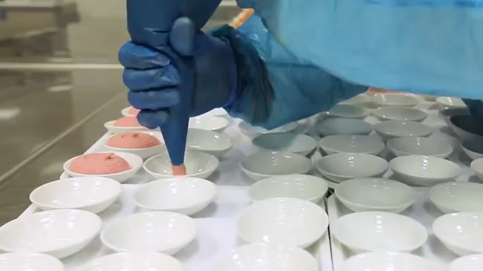
VIDEO - How Emirates Makes 225,000 In-Flight Meals A Day

Slide 8
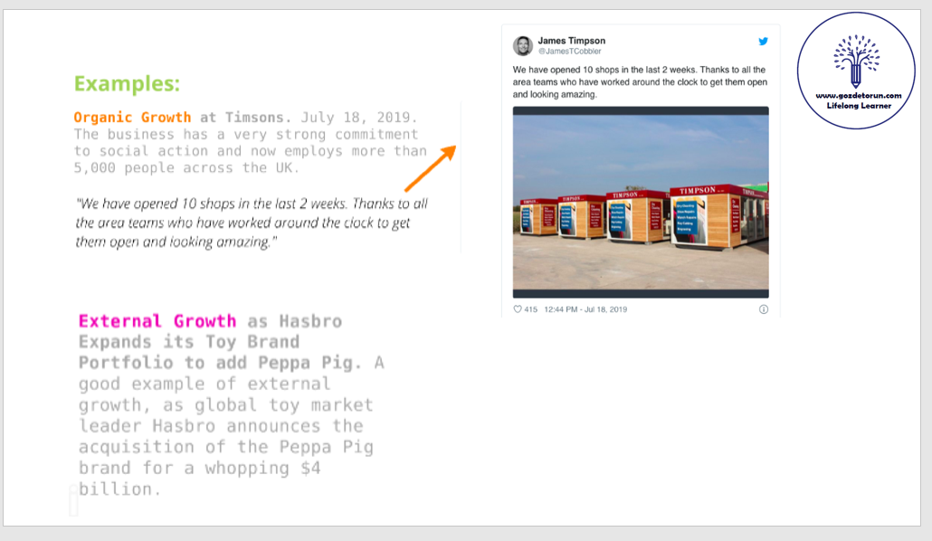

Slide 9

VIDEO - Hasbro buys Peppa Pig owner for $4 billion

