Slide 1
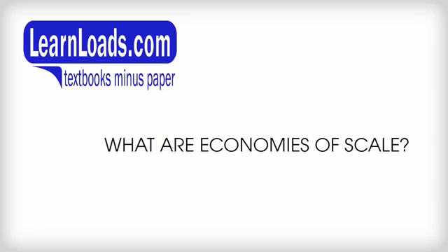
VIDEO - Economies Of Scale

Slide 2

VIDEO - Economies Of Scale

Slide 3

VIDEO - Sources of Economies of Scale

