Slide 1


REVIEW – THE FISHBONE DIAGRAM – CAUSE AND EFFECT
Notes:
https://www.youtube.com/watch?v=Fwfgx0dOYvE
https://www.youtube.com/watch?v=GlK-putpPAM

Slide 2
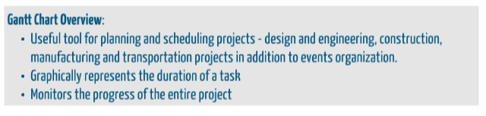
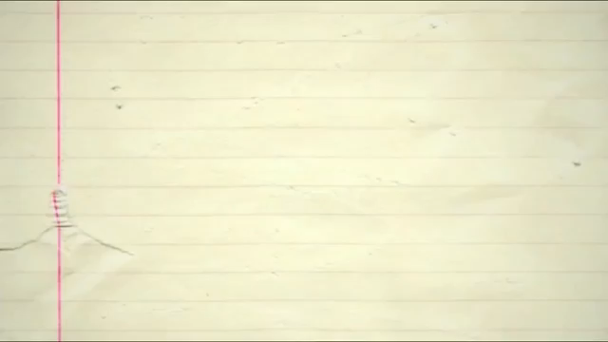
Notes:
https://www.youtube.com/watch?v=N92TOmT_Mcc

